Slide 1
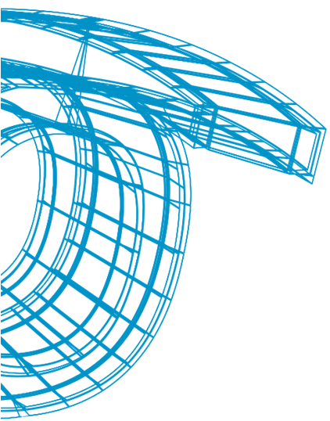

DETECCIÓN DE GESTOS PARA INTERACCIÓN Y REPRESENTACIÓN 3D ORIENTADO A ANÁLISIS
^{Jon Goenetxea Imaz}
^{jgoenetxea@vicomtech.org}

Slide 2
Contenido
Introducción
Centro
Antecedentes
Problemática
Objetivos
Estado del arte
Fases del proyecto
Resultados obtenidos
Conclusiones y líneas futuras

Slide 3
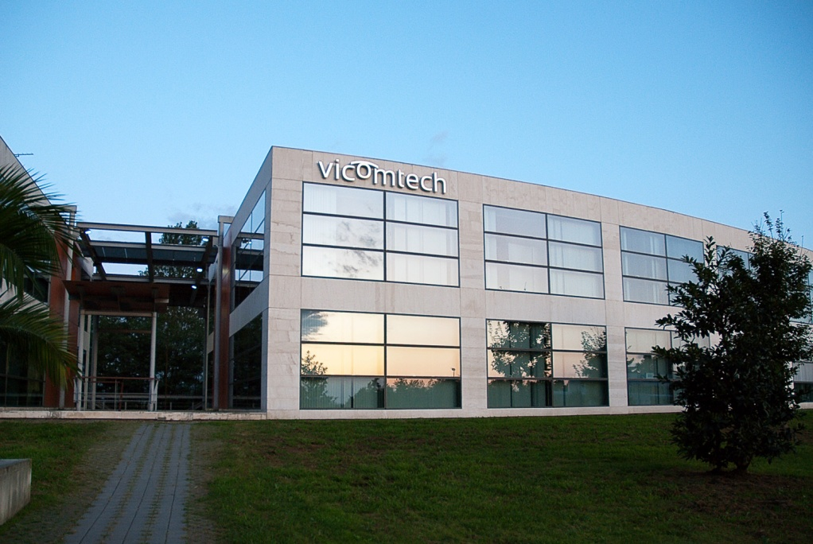
Centro
Vicomtech (Visual interaction communication technologies)
Centro de investigación aplicada
Diferentes áreas de investigación

Slide 4
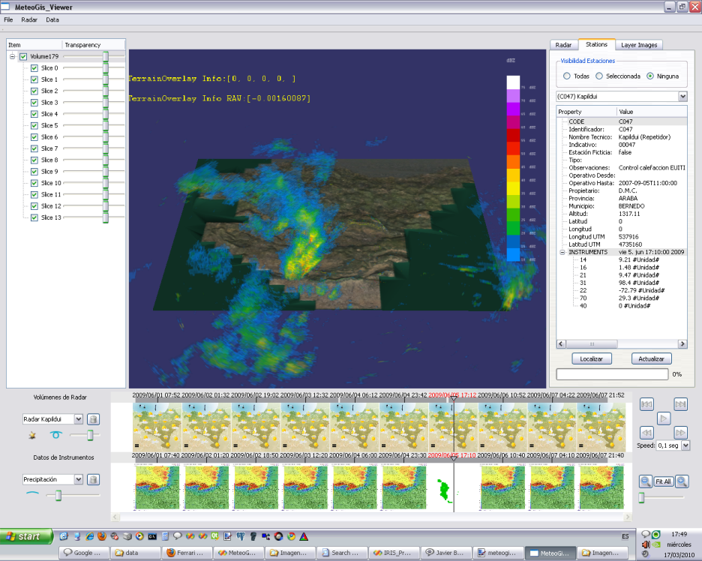
Antecedentes
Desarrollo basado en aplicación para análisis meteorológico
Aplicaciones que generan modelos de nubes
Orientados a sistemas de escritorio (Limitados a PC)
Desarrollos adicionales para entornos WEB

Slide 5
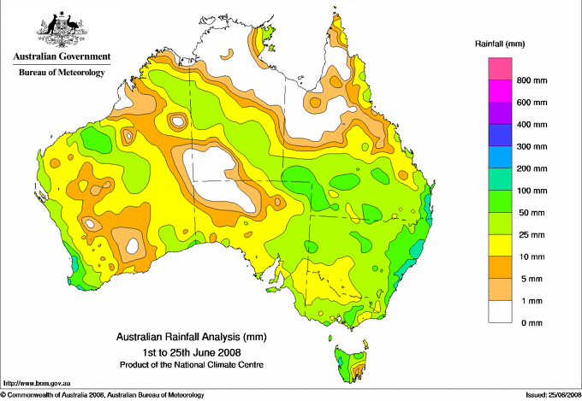
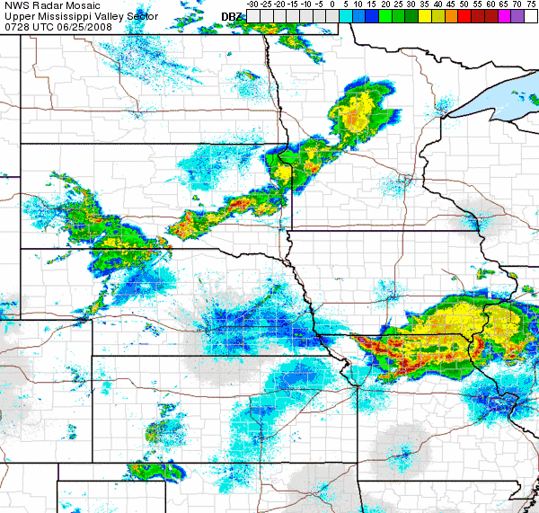
Problemática
Normalmente representaciones en dos dimensiones
2D → 3D/4D
Confuso o datos no representables
No accesible para usuarios inexpertos

Slide 6
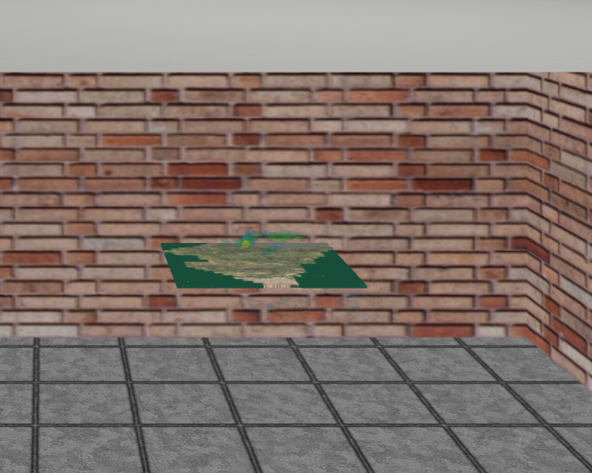
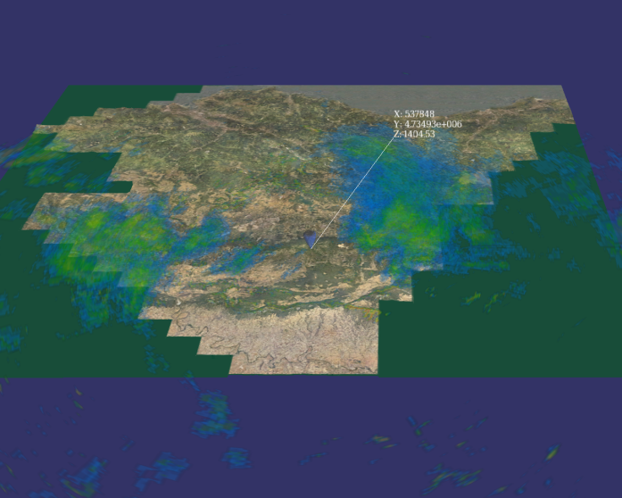
Objetivos
Representación 3D inmersiva e interacción intuitiva
Representar la totalidad de los datos
Percibir la profundidad utilizando sistemas estéreo
Entorno inmersivo utilizando perspectiva ajustada
Interacción con la representación utilizando gestos

Slide 7
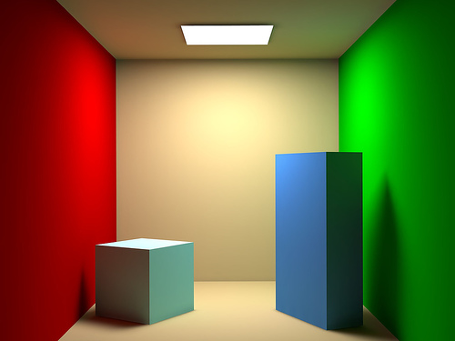
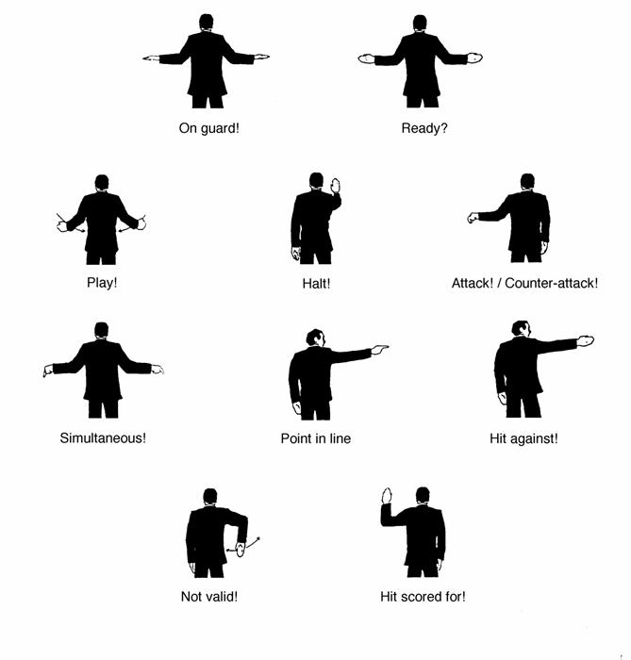
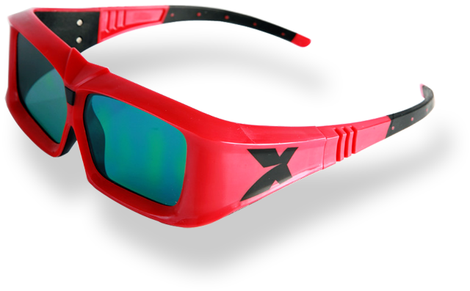
Estado del arte
Extensa utilización de los gráficos 3D
Tecnologías estereoscópicas en auge
Interacción gestual con grandes avances

Slide 8
Fases del proyecto
Conocimientos Necesarios
Representación 3D
e Inmersión
Representación 3D
e Inmersión
Interacción por gestos
Interacción por gestos
Demostración de algoritmos en entorno real

Slide 9
Desarrollo del proyecto
13 - Octubre
23 - Diciembre
30 - Junio
26-Marzo
3-Mayo
11 - Junio
Aprendizaje e investigación
Reconocimiento de gestos
Documentación
Estereoscopía y representación ajustada al usuario
Implementación de la aplicación de análisis meteorológico
Notes:
Comentar las diferentes tareas por encima, comentando un par de cosas de cada una
Las tareas principales.

Slide 10
Desarrollo del proyecto
13 - Octubre
23 - Diciembre
30 - Junio
26-Marzo
3-Mayo
11 - Junio
3-Mayo
11 - Junio
30 - Junio
Entrega del Paper
Entrega de la memoria
Presentación Congreso HAIS10
Notes:
Comentar las diferentes tareas por encima, comentando un par de cosas de cada una
Principales hitos del proyecto (Exceptuando los hitos técnicos).

Slide 11
Resultados obtenidos
Representación 3D
e Inmersión
Interacción por gestos
11

Slide 12
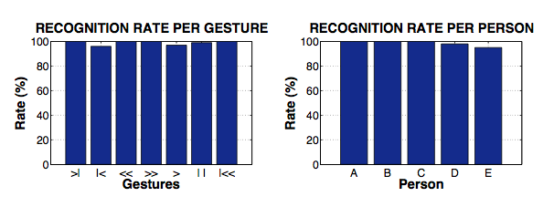

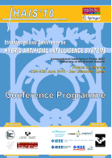
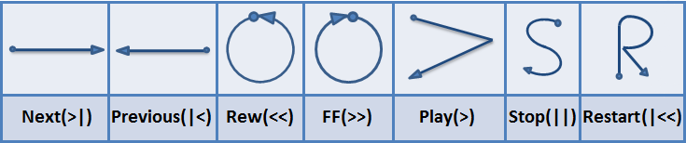
Resultados obtenidos
Sistema de clasificación de gestos
X 5 Usuarios
Clasificador de gestos ligero y rápido
Se adapta a diferentes estilos
X 20 Repeticiones
X 7 Gestos
Total: 700 Ejemplos de gestos
> 96%
> 95%

Slide 13
Resultados obtenidos

Slide 14
Resultados obtenidos
Representación 3D
e Inmersión
Interacción por gestos
14

Slide 15
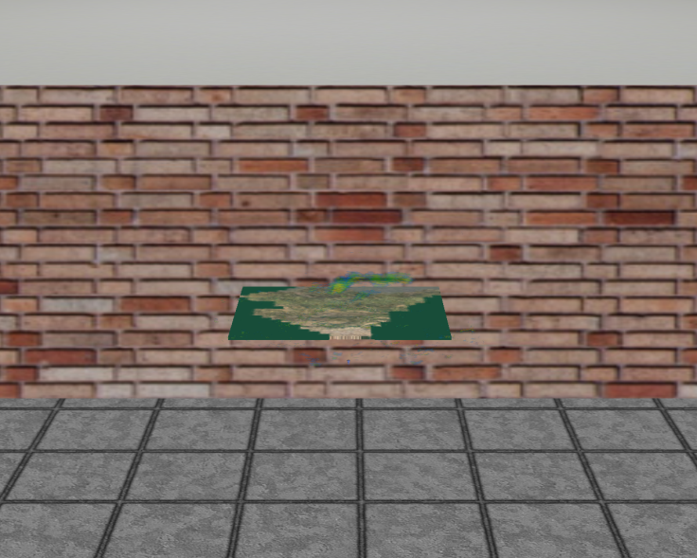
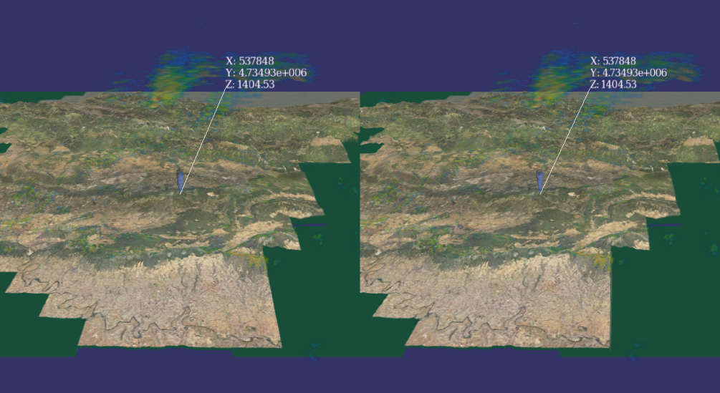

Resultados obtenidos
Representación 3D Inmersiva
Percepción de la profundidad utilizando 3D estereoscópico
Sensación inmersiva utilizando perspectivas ajustadas al usuario

Slide 16
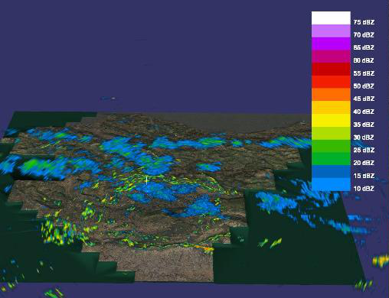
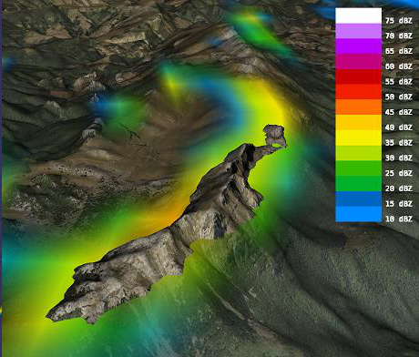
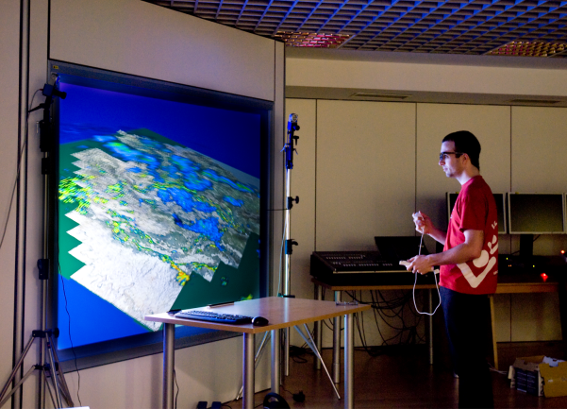
Conclusiones
La representación estereoscópica mejora el entendimiento de los datos representados
Se consigue sensación de inmersión
Representación estereoscópica
Perspectiva adaptada al usuario
La utilización de interfaces gestuales simplifica la interacción

Slide 17
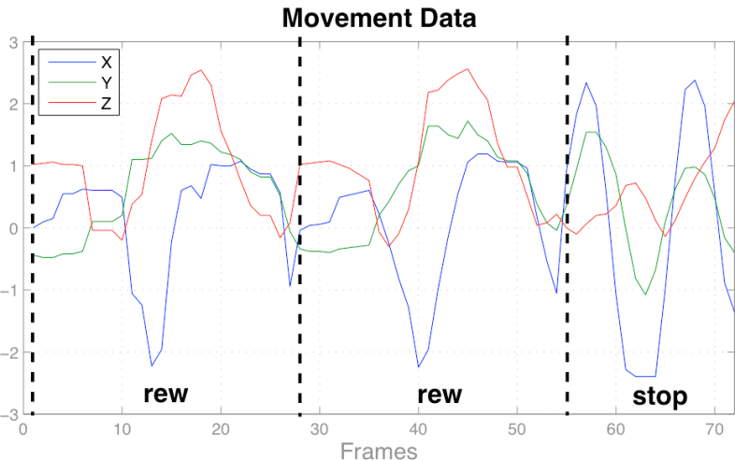
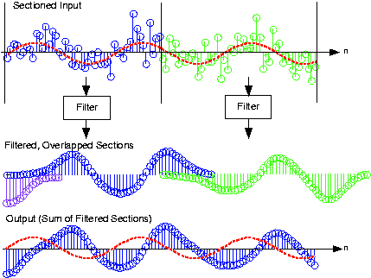
Líneas Futuras
Segmentación automática del gesto
Representar más datos (temperatura, presión,…)
Filtrar datos de captura

Slide 18
Gracias por su atención
¿Alguna pregunta?

Slide 19
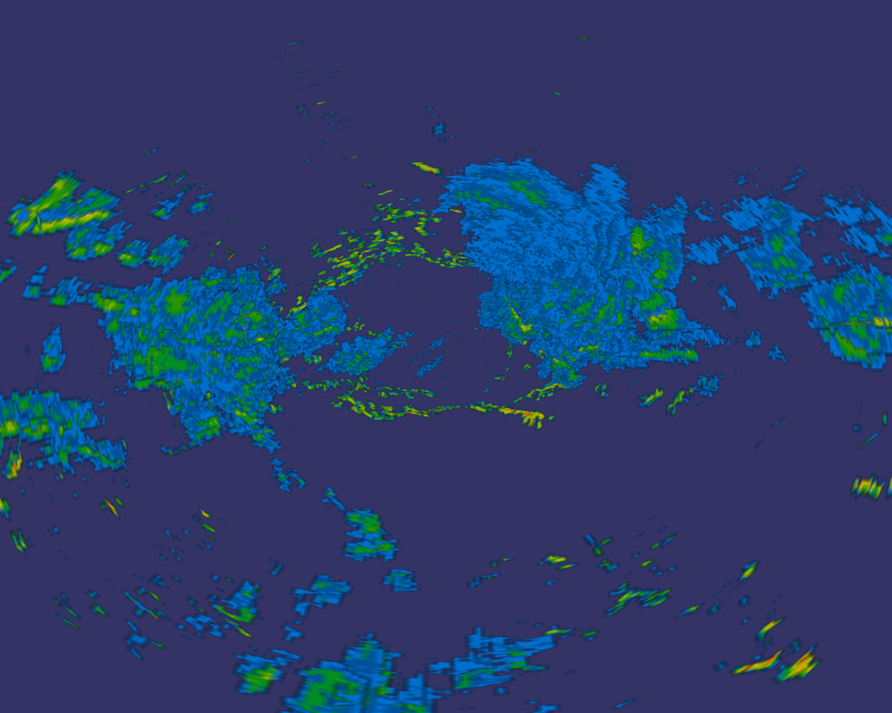
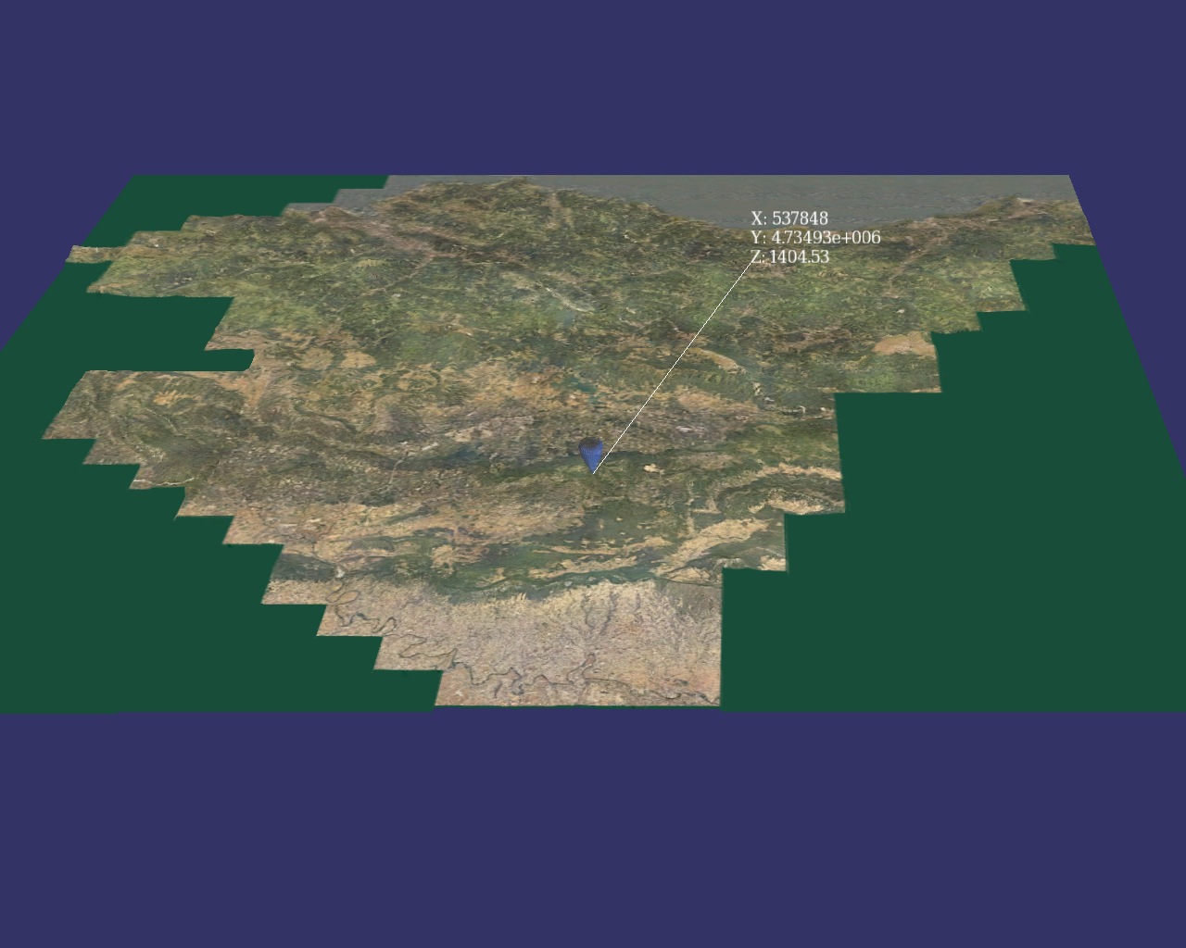

Representation and 3D visualization
Combination of Model Weather and 3D Model Terrain
3D coloured data model
3D terrain model
Model coordinates = Real world coordinates
Notes:
So now, we have a model witch represents the weather of that day.
In the other hand, we have a terrain model, witch represents the vasque coutri in this case.
Bouth models are based in real world coordenades, because of, is posible to combine them directly.
Now, we can see where the clounds were that day.

Slide 20
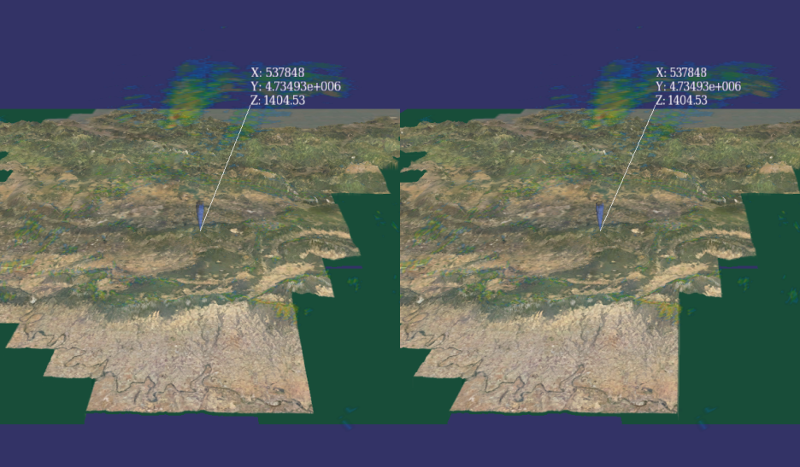
Representation and 3D visualization
Stereoscopic representation
Virtual perspective adapted to the users position
Notes:
We can represent the scene in a monitor or in a wall screen.
To give more information, a stereoscopic representation is used. Because of, is possible to show more information about radar data.
In common stereo implementations, when the viewer moves to other position, the image of the screen is the same.
The perspective isn’t change, but the viewer has a different perspective of the screen.
To avoid this, the viewer is tracked, and is possible to adapt the scene view to the viewers position.

Slide 21
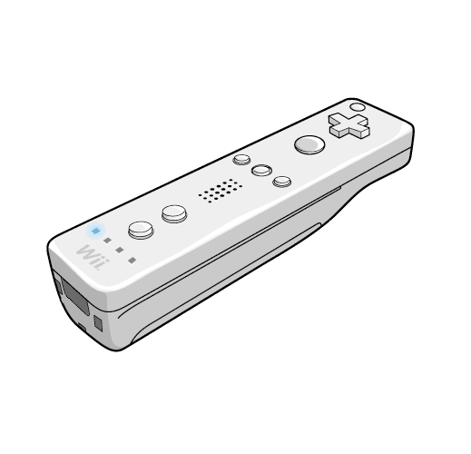
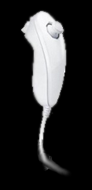
Gesture Interaction
Animation actions
7 gestures defined
Notes:
For the gesture interaction, seven gestures are defined.
Each gesture is defined as a different movement.
To capture this movement, the nunchuck auxiliar controllers accelerometer is used.

Slide 22
Gesture Interaction
Algorithm presented for Mena et al., adapted to different users and gesture styles.
To classify the captured movements, it is compared with each gesture stored in the database.
Samples database
Movement Stream
Captured gesture
Notes:
The algorithm presented by Oscar Mena is used to classify the gestures.
This algorithm is adapted to used with different people and gesture styles.
To classify a captured movement, this movement is compared with all the movement samples stored in the database.

Slide 23
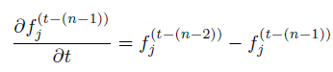
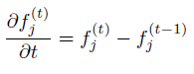
Gesture Interaction
Database is composed for N performances of each gesture.
All of the samples are resized using Cubic Spline before store them.
In classification, the captured data is resized too.
Samples database
Notes:
The database is composed by N repetitions of each gesture.
All the gesture samples are resized before store them using a cubic spline function.
Before compare the captured movement and the samples, the captured movement is resized too.

Slide 24
Gesture Interaction (How to classify)
It uses two values for classification:
A temporal advance between captured and database samples
The Euclidean distance between both captured and database samples
Classification
Temporal Advance Counter
Mean Distance Between Streams
Notes:
Two different values are combined to classify the gesture.
The temporal advance counter
The distance between stored and captured streams

Slide 25
Gesture Interaction
Temporal Advance Calculation
+1
DB Sample
A
B
C
D
E
F
G
H
Captured
Movement
A
A
D
C
D
C
C
H
Previous Nearest
Current Nearest
Notes:
The temporal advance counter, is calculated when the captured data is compared with a database sample.
This counter increments when the current nearest frame position is grater than previous nearest frames position.
This is an example of a counter increase.

Slide 26
Gesture Interaction
Temporal Advance Calculation
+0
+0
DB Sample
A
B
C
D
E
F
G
H
Captured
Movement
A
A
D
C
D
C
C
H
Previous Nearest
Current Nearest
Notes:
In this two examples, the current matched position is less than the previous, because of, the counter is not increased.

Slide 27
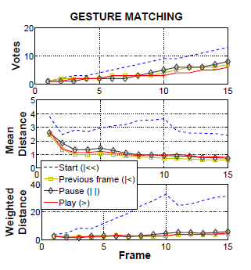
Gesture Interaction
Graphical matching representation
Notes:
In this graph, we can see the classification process of one gesture.
In the first the temporal advance counters progress, and in the second one, the mean distance.
If we multiply them, we obtain the weighted distance represented in the third graph.
This value is used to classify the gesture.

Slide 28
Experimental Results
Captured data (training gestures)
X 5 Different Users
X 20 Repetitions
X 7 gestures
Total: 700 Gestures
Notes:
For the experiments some data samples were captured.
We used five persons gestures.
Each person had done 20 repetitions for each gesture.
If we had 7 gestures, we have 700 samples to the database.

Slide 29
Experimental Results
Leave one out and test results
> 96%
> 95%
Notes:
With this samples, the classification algorithm is evaluated.
A leave one out method is used to estimate the algorithms accuracy.
In this two graphs we can see the results of the test.
In the first, all data samples are used, and are divided by gesture.
In the second graph, only the gestures of one person are used vs his own samples.
There we can see that the accuracy of the algorithm is higer than 95%

Slide 30
Conclusion
Interactive and stereoscopic hybrid 3D viewer for Doppler radar data
Stereoscopic immersive representation
Polarised retro-projected 3D representation
User position adapted perspective
Gesture interface using accelerometer data

Slide 31
Future Work
Automatic segmentation
More instruments added to the representation
Filtering and noise reduction

Slide 32
Thanks for your attention
Questions?

Slide 33
Pantalla
1
2
desplazamientoHorizontal

